Slide 1
The Budding GDB
A Data Model for Report Maps
Seth Docherty
GIS Specialist – NJDEP: Bureau of Tidelands
(e) sddocherty@gmail.com
(we) seth.docherty@dep.nj.gov
Notes:
Today I’m going to be presenting to you a conceptual design I’ve created called the Budding GDB. This design is specifically geared towards map creation for reports in a map production environment.
Creating figures can be quite a laborious process. In order to meet my deadlines, I had to devise a workflow to expedite this process.
From that, I’ve developed this data structure based on hundreds of maps and figures I’ve generated from various projects I’ve worked on.
I went from working on a set of maps that used to take three weeks but with this design, they can be completed in one day.
Today, not only am I going to discuss this data model, I will be providing you with the tools that I developed to use in your own projects.

Slide 2
Presentation Topics
Overview of the Budding Geodatabase (GDB) concept
Features and the Toolset
Updating figures with the toolset
Notes:
For this presentation,
I will start with an overview of the conceptual design of the Budding GDB and the underlying data structure.
An overview of the required features and the toolset I’ve developed
And finish off with some examples of updating figures with the toolset.

Slide 3
Overview of Budding GDB concept
The Budding GDB
A data structure designed for report map creation.
Set of ETL (Extract->Transform->Load) tools, emulate a one-way replication system to keep a child GDB synced to the parent GDB
Notes:
As I mentioned before, the Budding GDB is a structure designed for report map creation.
To make this design work, I’ve developed a set of ETL tools, written in python, to emulate one-way replication. This ensures consistency between a child geodatabase and parent geodatabase, in a disconnected environment.

Slide 4
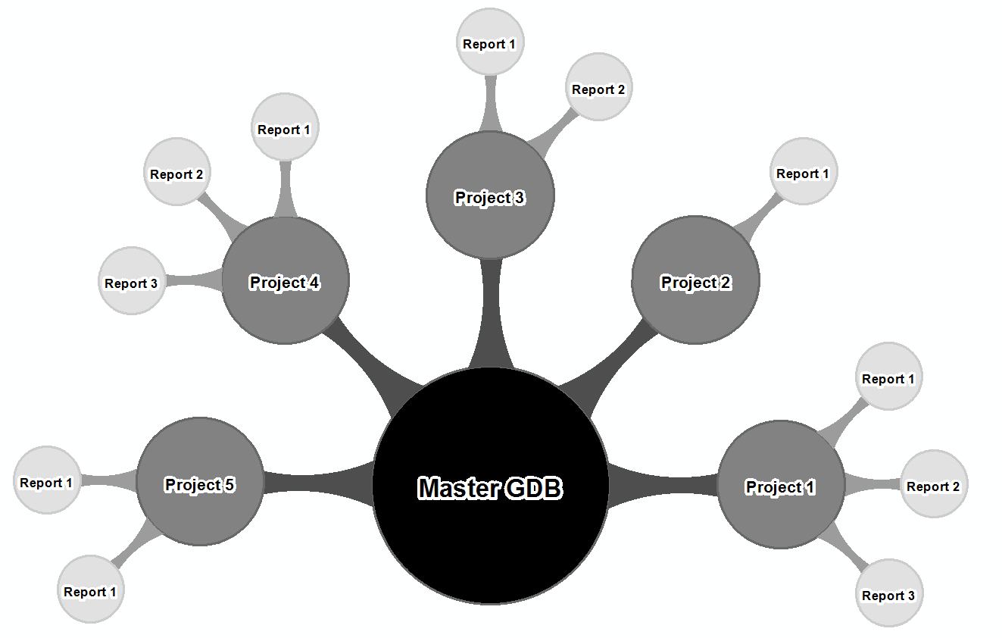
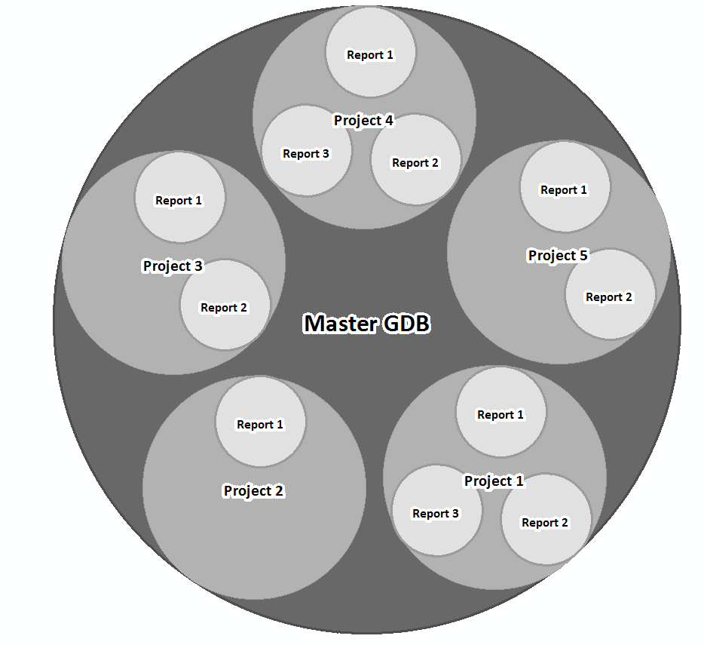
Overview of Budding GDB concept
Normally, project related features are stored in a single database.
The budding GDB data structure containerizes each of the projects.
Notes:
Typically, a program will store all their project data in a single database. In that database, only a few of these GIS layers will be the main layer of focus in most maps.
Well if most projects are using a couple GIS layers in their maps, they are most likely adding multiple fields to these layers to fulfill the needs of the project in the map production environment. Overtime, the attribute table will become messy and honestly, quite overwhelming. Which field do you use and are you even using the right field?
You also deal with the issue of multiple people working on the same GIS layer which is not possible without replication and versioning.
Next Picture
With Budding GDB structure, projects are separated into their own containers to solve the issues I just mentioned.
Containerizing your data for your mapping needs gives projects the flexibility to create necessary the fields in those GIS layers. If there is a GIS specialist tied to each project, that can alleviate the burdensome database locks so they can edit the GIS layers in a map production environment.

Slide 5
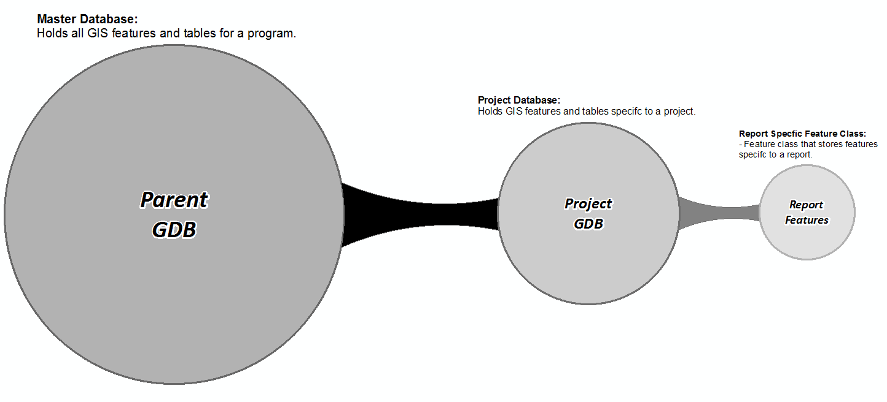
Overview of Budding GDB concept
All projects branch off a single parent GDB.
A project GDB stores all the features related to a project.
Each project GDB contains project specific report features.
Features from Parent GDB are replicated and stored in a report specific feature class.
Uses the schema from the Parent GDB.
Stored within the project specific GDB.
Notes:
The conceptual idea for the budding GDB data model can be broken down into 4 fundamental characteristics:

Slide 6
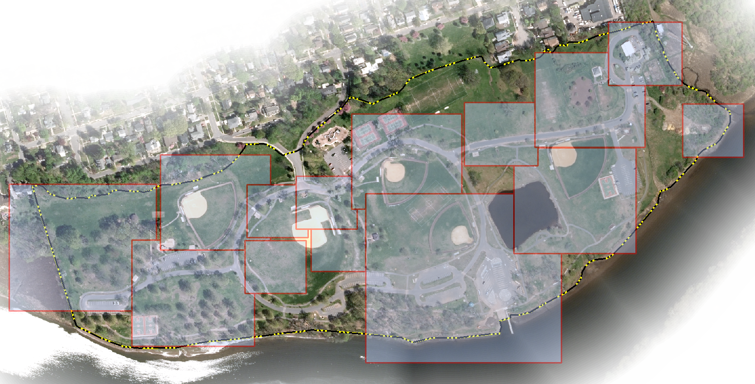
Data Model Requirements
Features and the Toolset
Report specific feature classes:
Replicated layer of interest from parent GDB
Figure Extent
Boundary Extent*
Feature Linked Annotation*
Notes:
In order to start creating maps with this data model, you need to create report specific feature classes.
The first feature class is the GIS layer that will be replicated from the parent GDB.
A figure extent which stores the spatial footprint of the data frame.
And optionally:
A boundary extent which can be used to spatially filter out features within a figure.
And feature linked annotation.
While this feature is not required it’s highly recommended as you will see in upcoming slides.
To help you visualize the purpose of each report specific features class, think of each figure footprint as a window into your GIS data and features are spatially tied to each figure. Since those features are tied to a figure, you can quickly filter/update by a specific figure.

Slide 7
Typical Issues in the Map Making Process
Features and the Toolset
Creating maps can be quite a laborious process.
Revisions most of the time mean you have to completely re-do the map.
The two key patterns in most revisions are:
Extent of the data frame in the figure will dictate the size of the label and the placement.
Attributes from the feature class getting labeled dictate the annotation properties and symbolizing features.
Notes:
As I mentioned earlier, creating maps is a laborious process. It’s more than just bringing in some GIS layers and pressing the print button. A lot of thought and planning goes into designing a map.
So you make the first set of maps and send them over to your client. A couple of days later, you get them back and they are all marked up:
Zoom in here, don’t show this, highlight these features etc…
Most revisions require you to completely re-do maps.
In my experience, the two key patterns I’ve seen in most revisions are due to the:
Extent of the data frame. This will dictate the size and placement of the label.
The feature class attributes dictate the annotation properties and symbolizing features.
The map size; That will dictate your map layout and how items will be represented.
You set the map’s agenda by selecting attributes and features to symbolize.
Labeling features will help reduce complexity by bringing out patterns within the dataset.
Those are just a few ideas to keep in mind when designing to best convey your message

Slide 8
Toolset to keep it up to date
Features and the Toolset
Since a user is working in a disconnected environment, what happens when new features are added to a parent GDB or if attributes are updated? What about updating tables?
Three ETL tools have been created to mitigate these issues:
Add new spatial features to replicated report feature class.
Update attributes of replicated report feature class.
Add new records to a table.
Notes:
So if a user is working in a disconnected environment, what if new features are added or attributes are updated in a parent GDB? What about keeping a table up to date with new records?
To mitigate these issues, I’ve created a set of ETL tools to emulate a 1-way replication system. This is to improve accessibility of data to meet a projects needs.
The first script is for adding new features to the replicated report feature class
Another for updating the attributes of a replicated report feature class
And a tool for adding new records to a table from a database query.
Some examples on using this toolset for updating figures.

Slide 9
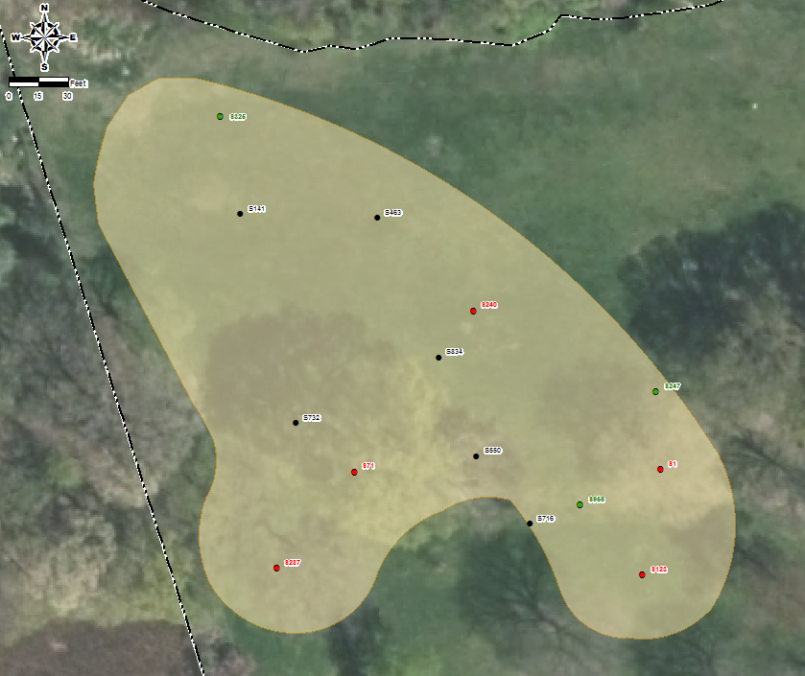
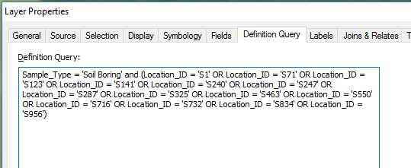
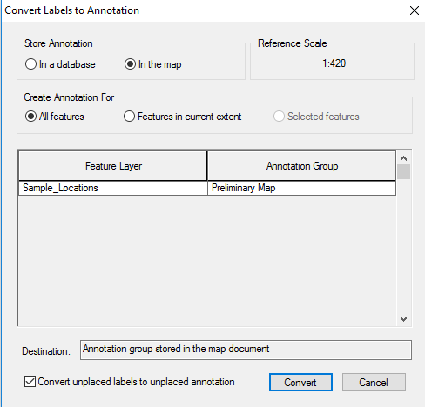
Adding New Features to a Figure
Updating figures with the toolset
Action Item: Client requested to add latest round of sample locations to figure.
Background: In this map your client wants to show the sample locations within the boundary and does not want to show monitoring well’s.
How would you go about adding the new locations?
Notes:
In this example, the client has asked you to add the latest round of sample locations to an existing figure.
In this particular map, we specifically want to show sample locations within the this boundary and filter out monitoring wells.
Typically, you would create a map like this by selecting the locations within the boundary or by writing out a definition query. You know the client is very particular with label placement, so you have created annotation that is stored in the map.
With this request, how would you go about adding new locations to the map? You could manually find the new locations and create a layer selection or manually update the definition query. But In either case, you are basically re-creating the map by performing the same exact workflow to make the update.

Slide 10
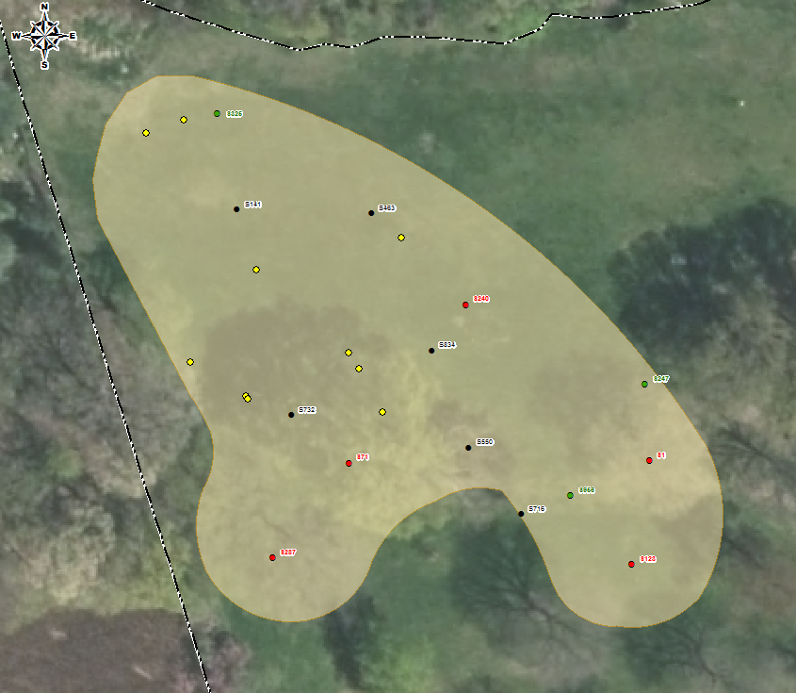
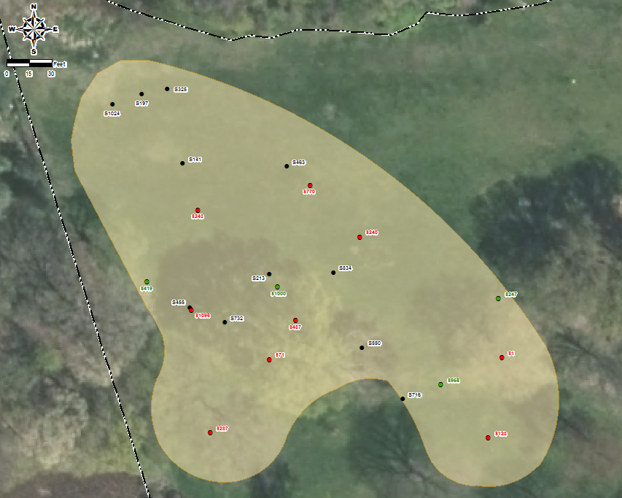
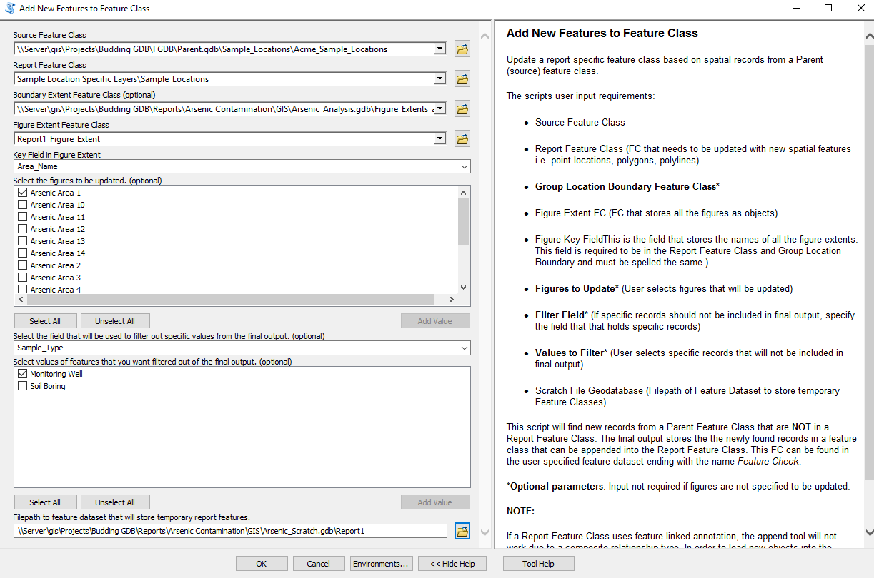
Adding New Features to a Figure
Updating figures with the toolset
Automatically add the new features to the figure!
This script adds new features to a report feature class.
New features are not immediately appended to the report feature class.
Stored in temporary feature class for verification.
Some built in features include:
The ability to add new features to a specific figure.
Filter out specific features.
Notes:
Or you could automatically add the new features and the labels will automatically generate.
With the budding GDB data structure and the add new features ELT script, it will automatically find new features since the figure was last updated.
The new features are stored in a temporary feature class which the user can verify before adding said features.
NEXT
Some features built into this script is the ability to add features to a specific figure as well as filtering out specific features.
In this example, the client wanted to show sample locations within the boundary and did not want to show monitoring wells.
Picture Slide Show
So this is what we started with -> we ran the script and found the new features -> we appended the new features. With feature linked annotation, the labels are automatically created.

Slide 11
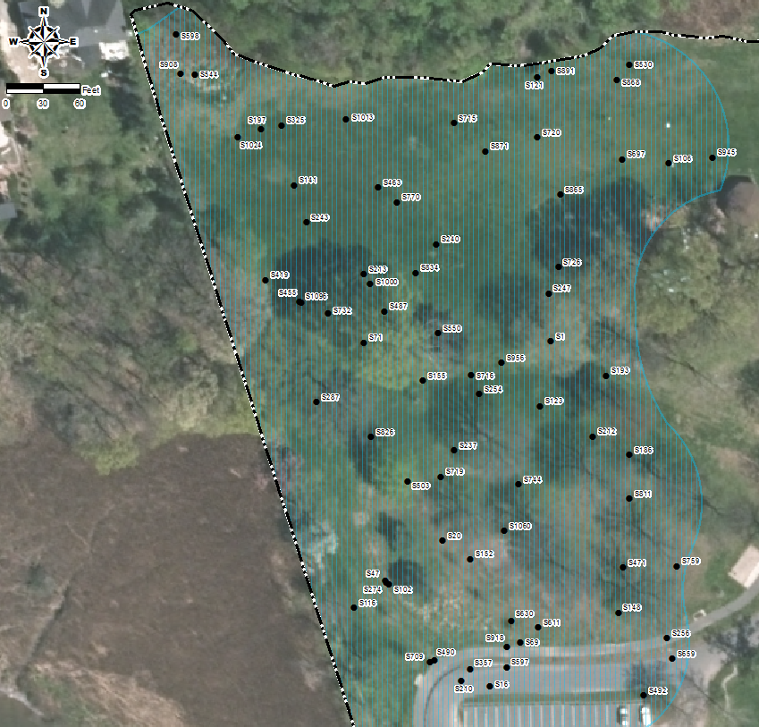
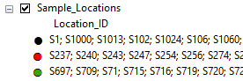
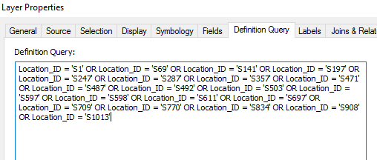
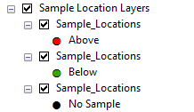
Updating figures with the toolset
Update Feature Attributes in a Figure
Action Item: Client requested to show sample locations that were tested for lead. They also want to label features so they can easily discern dirty and clean samples.
How would you go about symbolizing/labeling features?
Notes:
In this example, the client has asked you to show sample locations that were tested for lead and label features in a way to easily discern dirty and clean samples.
In this particular map, we need to categorize sample locations based on the analytical results and if they meet the soil remediation standards.
NEXT
From my experience, here are a couple of ways that I’ve seen it done:
You could group by location id (I do not recommend this approach)
You can duplicate multiple layers and set a definition query for each category and label/symbolize appropriately.

Slide 12
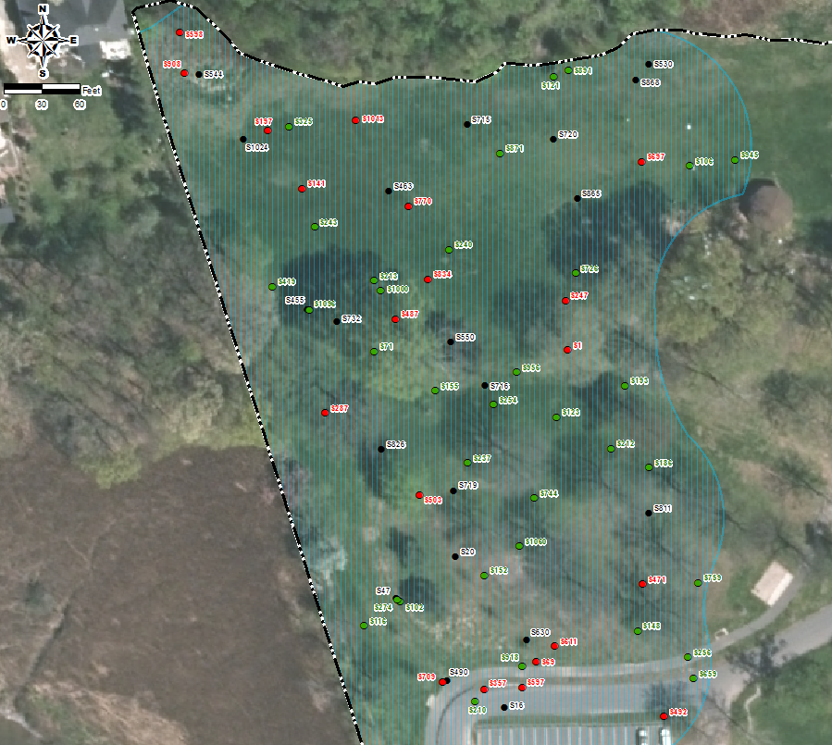
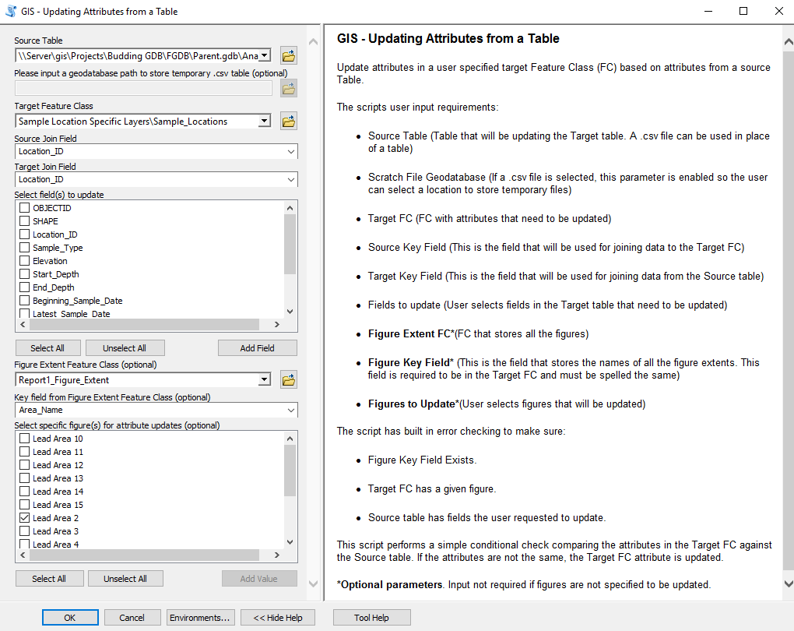
Updating figures with the toolset
Update Feature Attributes in a Figure
Automatically updates feature attributes in the figure!
Update the attributes of a report feature class.
Some built in features include:
Update attributes for a specific figure.
Select a set of fields to update in the report feature class.
Update attributes from a table, feature class, or .csv document.
Notes:
Or you could automatically update attributes in the figure.
With the budding GDB data structure and the update attributes ELT script, it will automatically update feature attributes in a figure.
NEXT
Some features built into this script is the ability to:
update feature attributes for a specific figure
As well as selecting the fields to update in the report feature class.
You can also update attributes from a table, feature class, or .csv document.
Updating from a csv document is real handy as I can quickly add the results from some analysis done in excel to my feature class.
This what the map looked like before running the script -> and this is what it looks like now. Using feature linked annotation, you can easily update label properties from the feature attributes.

Slide 13
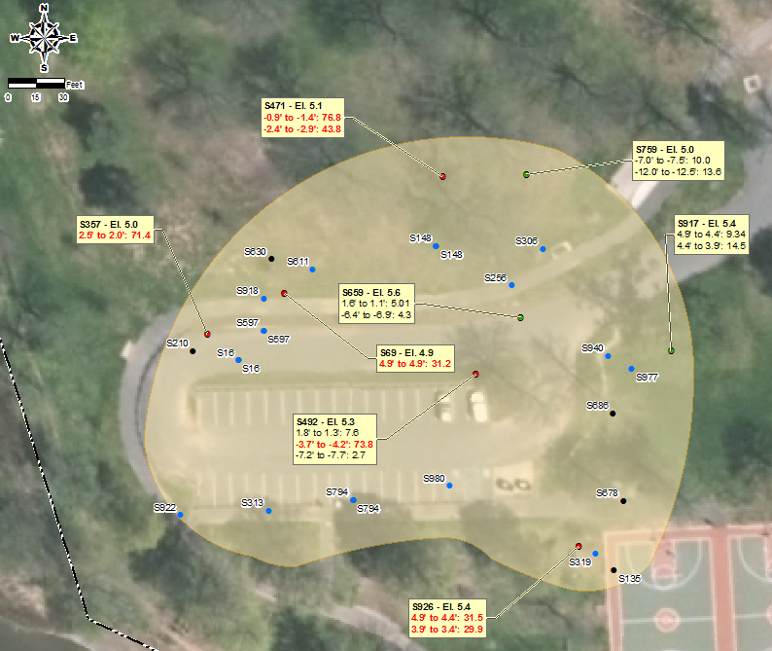
Updating figures with the toolset
Add New Sample Results to ArcMap Table
Action Item: The client requests to show the latest sample results for each location by depth.
Background: The sample result label boxes are generated based on a related ArcMap table of analytical results.
How would you adding new records to the ArcMap table?
Notes:
In this last example, the client has requested to show the latest sample results for each location by depth. They also want to highlight the sample results that are above.
You have already created a preliminary map but it hasn't been updated in a while.
The blue points in this picture have been added since the figure was last updated. The referenced ArcMap table needs to be updated with new analytical results since the sample result boxes are generated from that related table.
If you were given a data dump from a database query, this would require you to compare both tables, row by row to find new records.

Slide 14
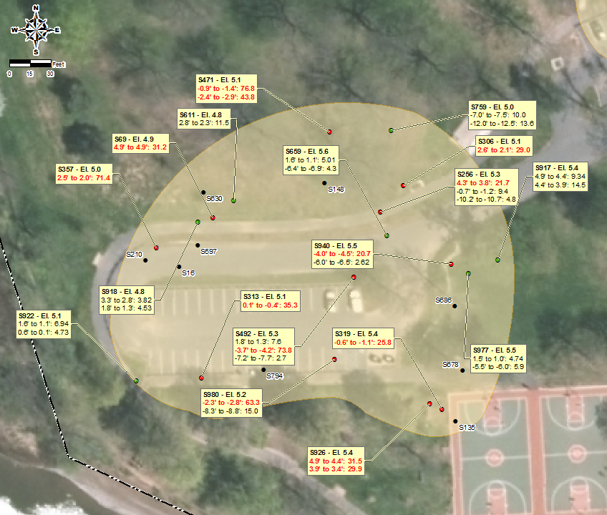
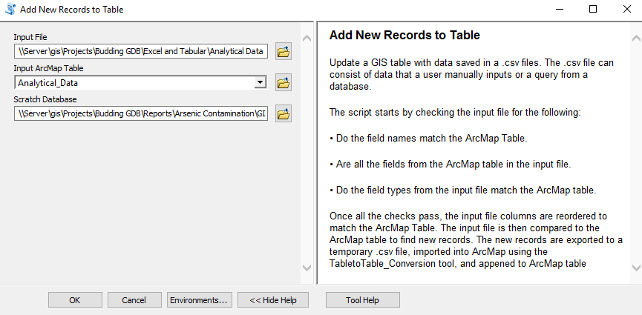
Updating figures with the toolset
Add New Sample Results to ArcMap Table
Automatically add new records to a table!
Add new records from a database query to an ArcMap table.
Script compares input .csv document and ArcMap table.
Manually doing this is no easy feat but with python, its much easier.
No strict requirements for the input .csv document:
Field order does not need to match the ArcMap table.
Fields in ArcMap table must be in the .csv document and spelled the same.
Notes:
Or you could automatically update the table with new records.
With the budding GDB data structure and the add new records ELT script, it will automatically do the row by row comparison to find the new records and then add them to the table
The basic requirements for the script are:
The input document must be a .csv
And the fields in the ArcMap table must be in the csv document.
Before running the script this is what it looked like ->and after adding the new analytical data, the sample result label boxes are automatically generated for the new locations.

Slide 15
Utilizing ArcGIS built in tools
Updating figures with the toolset
Effortlessly create maps with ArcMap's built-in tools.
Arcpy library functions built into ETL python scripts.
Feature Linked Annotation
Label updates are quick and easy
Attributes can control label size/properties
Data Driven Pages
Quickly generate pdf’s in a few clicks
Figure Extent feature class is used as index layer
Notes:
The Budding GDB data model is optimized for map/figure creation when you use some of the tools built into ArcMap.
Many functions from the arcpy library were chained together to bring the ETL scripts to life.
Feature linked annotation plays a big role in quickly making updates to labels since attributes control label size and the label properties.
Data driven pages can quickly generate report figures in a few clicks. By setting the figure extent as an index layer, it loops through each feature and exports each figure to pdf.

Slide 16
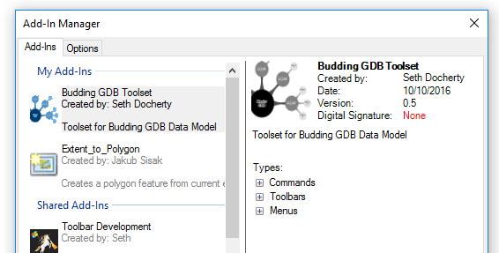
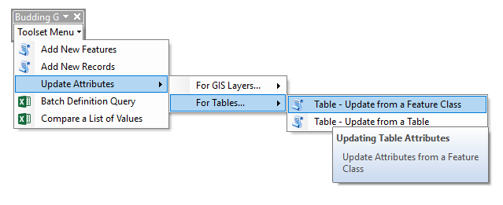
Where Can I Get This Toolset?
All my code has been uploaded to GitHub
https://github.com/SethDocherty/Budding-GDB
Install add-in and enable the toolbar to start using!
Other tools and reference documents can be found in the repository.
Notes:
So I have showed you some useful tools today and you may be wondering where you can find them?
Well I’m a big proponent of open source technology and sharing knowledge, so I have uploaded all my scripts to a github repository. If you come across any issues or bugs, feel free to post an issue.
I’ve also created a python add-in so you can quickly add the toolbar to your layout for ease of access.

Slide 17
Questions?
Seth Docherty
GIS Specialist – NJDEP: Bureau of Tidelands
(e) sddocherty@gmail.com
(we) seth.docherty@dep.nj.gov
https://github.com/SethDocherty/Budding-GDB

